Slide 1
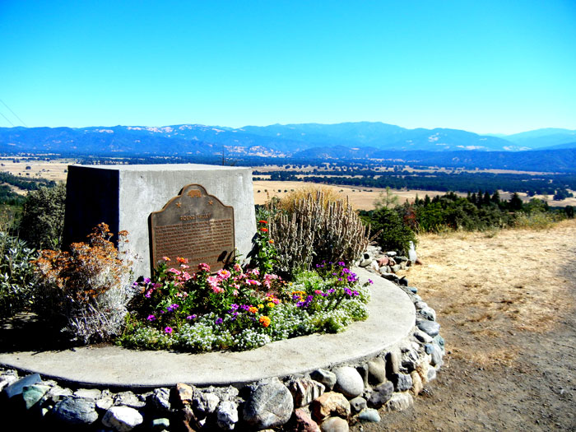


How to Complete Round Valley Land Buy-Back Program
Purchase Offer Packet

Slide 2
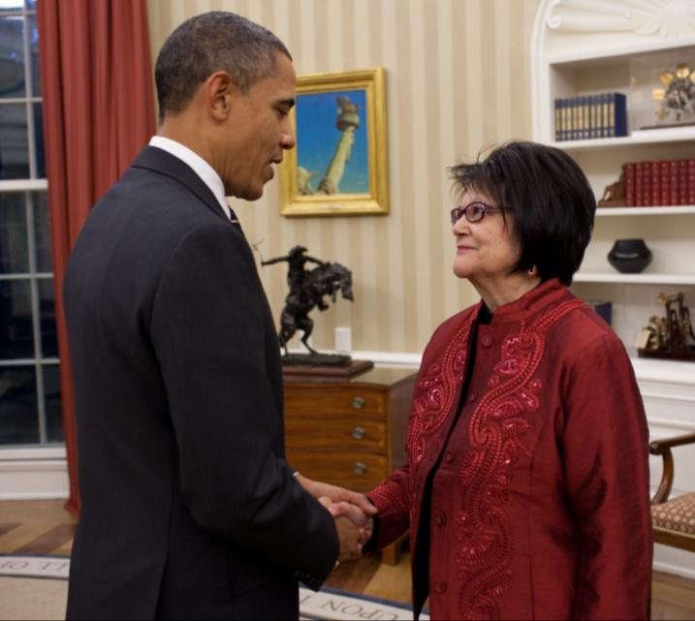
What is the Buy-Back Program?
Created to implement the land consolidation component of the Cobell Settlement Agreement, The Settlement provided a $1.9 billion fund to purchase:
fractional interests
in trust or restricted land
at fair market value
from willing sellers
within a 10-year period
Goal: Keeps land in trust - purchased lands are immediately held in trust for the recognized tribe jurisdiction over the land.
President Barack Obama with the late American Indian Activist Elouise Cobell
2

Slide 3
What is the Buy-Back Program?
Landowner
Tribe
Collaborative Effort
To reduce the number of fractional interests in tracts of trust or restricted lands.
Fractionated tracts are defined as any tract with more than one landowner.
DOI
Program Office
BLM
DME
OAS
BIA (AC, LTRO, Local Agencies)
OST (Trust Services, Field Operations, TBCC)
Notes:
The Fund is made up of $1.55 billion for acquiring fee interests, a maximum of 15% of the total $1.9 billion fund ($285 million) of the for implementation costs, and $60 million for Scholarship Fund contributions

Slide 4
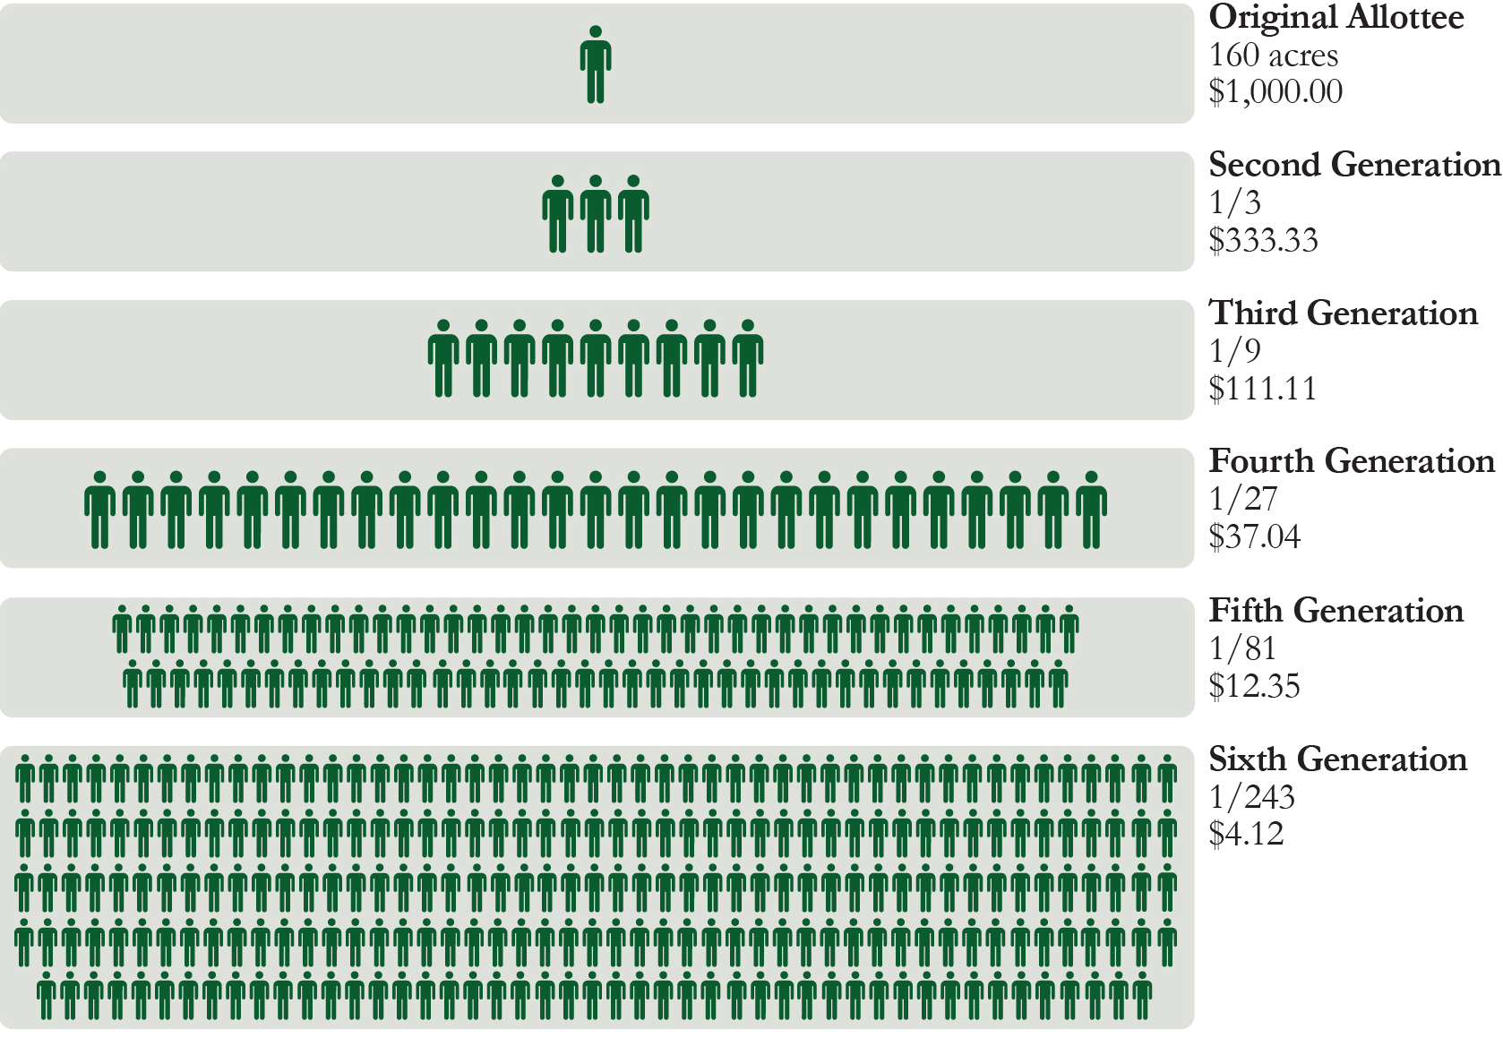
Fractionation: A serious problem facing tribal communities
As tracts (or allotments) of lands are passed down through generations, they gain more and more individual owners.
Because the number of owners make it difficult to use the land, these allotments often lie idle and cannot be used for any beneficial purpose.
There are approximately 150 tribal locations with fractionated land, with approximately 245,000 unique owners.
For illustrative purposes only
4

Slide 5
How Does the Program Work?
  The Buy-Back Program makes offers to purchase fractional interests in trust or restricted lands (tracts with more than one owner).
  Landowners can choose to sell some, all, or none of their fractional land interests. Participation in the Program is strictly voluntary.
  Landowners will receive payments in their Individual Indian Money (IIM) accounts for interests that they choose to sell.
  Purchased interests will be immediately held in trust for the tribe with jurisdiction over the land.
Notes:
Explain concept of common areas and undivided interests
Hold up a bottle of water and analogize to tract of land owned by many people. An undivided interest is similar to an individual owner who has a drop or several drops of interest in a bottle of water, but no particular drop in the bottle is theirs. Therefore, both the small amount of water interest and in no particular place can make it difficult to use the land

Slide 6

Program Priorities?
Landowners: Foster informed landowners; responsible decision making; and Program participation.
Tribes: Strengthen partnerships and respect and uphold tribal sovereignty. Tailor efforts to each location based on tribal involvement and priorities.
Timely use of the Fund: Expend the Trust Land Consolidation Fund by purchasing land from interested landowners to reduce fractionation and expand tribal ownership. Remain flexible and open to constant learning and improvement.
Notes:
Note: The Fund should be used within the 10-year time frame ending November 2022 according to the Settlement.

Slide 7
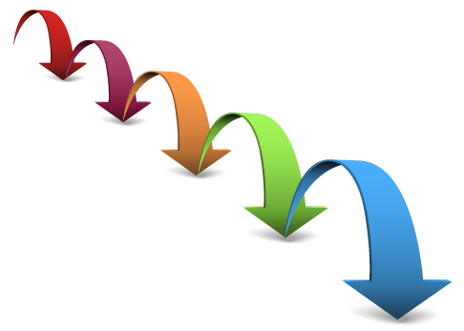
Major phases of the Program
    Outreach: Inform landowners about the Buy-Back Program, answer questions, and assist tribes with identifying their priority tracts for acquisition.
    Land research: Collect information necessary to establish fair market value for fractionated tracts that might be acquired.
    Land valuation: Determine the fair market value of tracks where DOI will offer to buy fractional land interests.
    Land acquisition: Purchase interests in fractionated tracts that individuals would like to voluntarily sell.
Notes:
Outreach occurs throughout the process (from the cooperative agreement signing to closeout of Program with the tribe)
2- Land Research is done by (DME, BLM, BIA) – expand on what each group is doing
Note from OAS- Land research consists of inventorying all the legal, social and physical characteristics or attributes of every tract. It necessarily involves many different agencies. BIA for example, because they maintain the title/legal information for every tract; BLM for the mapping; DME for the mineral rights; Forestry for the timber component; OAS for market and physical characteristics, etc., etc.
3- Valuation
Note from OAS- Regardless of the method used, I believe it is important to emphasize that all appraisals performed for the program have the same objective, which is to determine the 'fair market value' of the property. OAS will employ whatever appraisal methodology is best suited to meet the needs of each location, based on the most efficient allocation of program resources. All program appraisals, regardless of methodology, adhere to established appraisal standards.
4- Acq

Slide 8
Who is Responsible for Land Valuation?
The Office of the Special Trustee for American Indians (OST), Office of Appraisal Services (OAS) is responsible for appraising tracts of land and incorporating any contributory value from timber and mineral estates.
The Division of Minerals Evaluations (DME) is responsible for the valuation of mineral interests.
BIA and “638” compacting/contracting tribes are responsible for providing timber values.
All appraisal methods used by DOI conform to the Uniform Standards of Professional Appraisal Practice (USPAP).
To ensure a credible and robust valuation process, DOI worked with the non-profit The Appraisal Foundation (TAF) to obtain an independent review of DOI’s methods.
Appraisals may be requested through the Trust Beneficiary Call Center 888-678-6836 Hand-outs: Appraisal Fact Sheet & Mineral Evaluation

Slide 9
Key Points to Remember
The personal information on the Deed must be correct
The documents cannot be altered
The Deed must be signed and properly notarized
The landowner’s selections must be clear
The original signed and notarized Deed, and all pages of both parts of the Inventory must be returned by
June 24, 2016
[CALIFORNIA RESIDENTS include California All-Purpose Acknowledgement]
Once approved, the sale cannot be reversed

Slide 10

Step 1: Review the Offer Package Documents
Cover Letter (2 pages)
Instructions (1 page)
Deed (1 page)
Exhibit A – Purchasable Interests Inventory (two parts)
    DETAIL (1 or more pages)
    SUMMARY (1 or more pages)
Map(s) (1 or more pages)
Business Reply Mail Envelope
Important Note:
Everything with a Bar Code
must be submitted to be considered as a complete package.

Slide 11
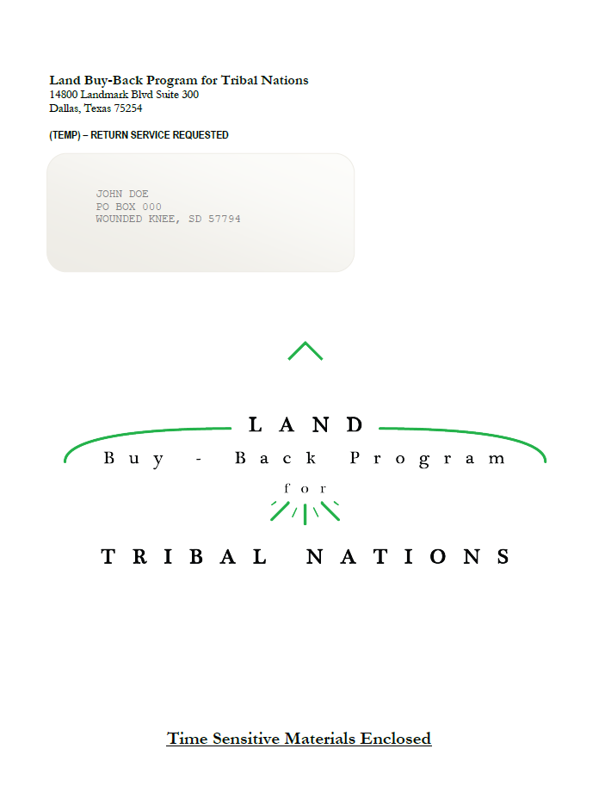
Envelope Containing Offer Package
11” x 13”
Step 1 (con’t): Review the Offer Package Documents
LBBP Logo

Slide 12
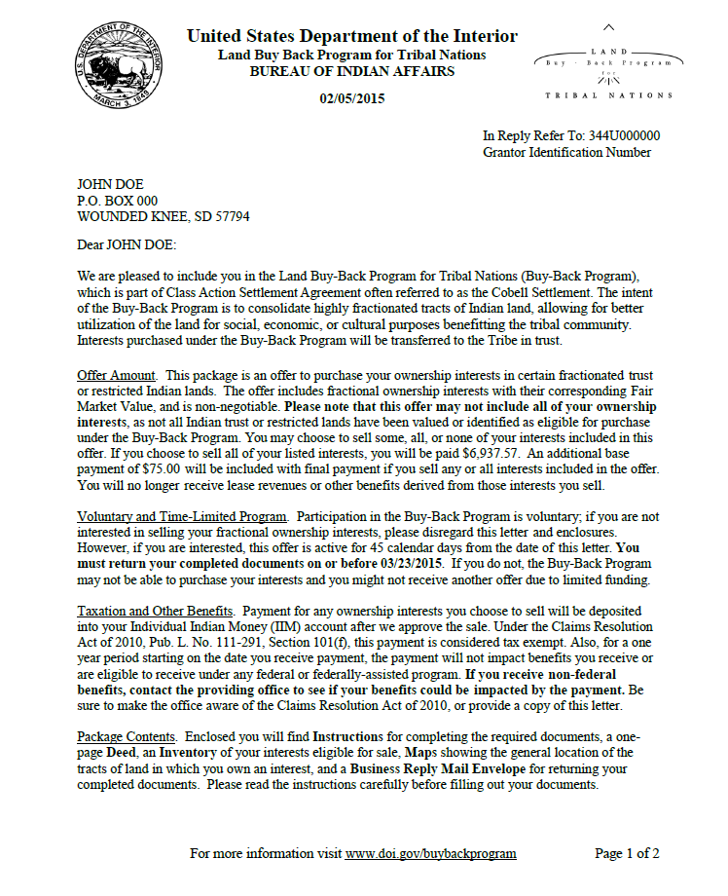
Cover Letter Page 1
Step 1 (con’t): Review the Offer Package Documents

Slide 13
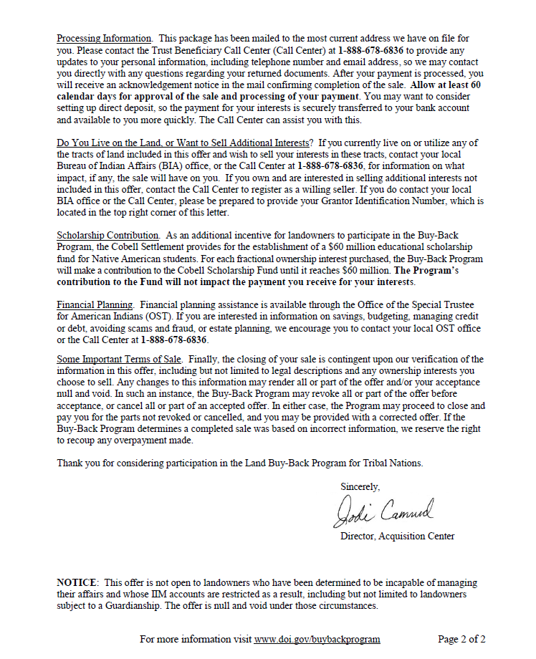
Cover Letter Page 2
Step 1 (con’t): Review the Offer Package Documents

Slide 14
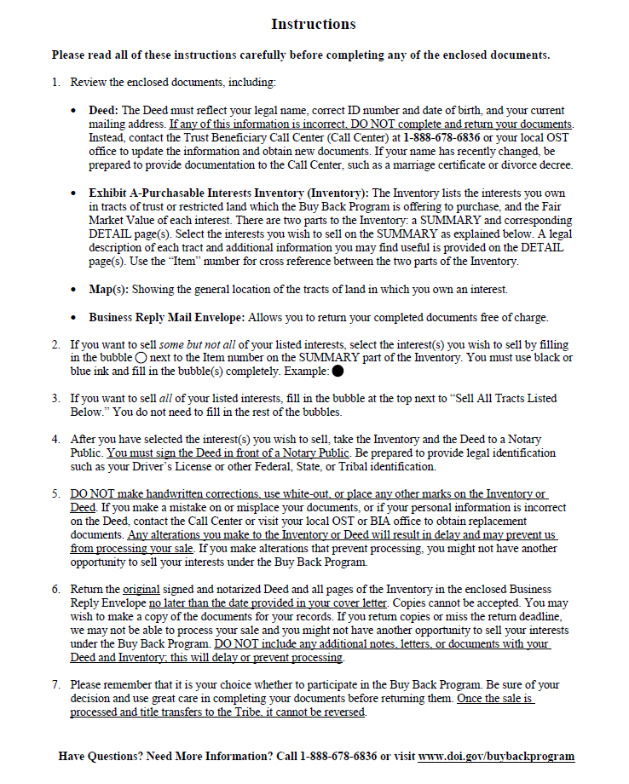
Step 1 (con’t): Review the Offer Package Documents
Instructions

Slide 15
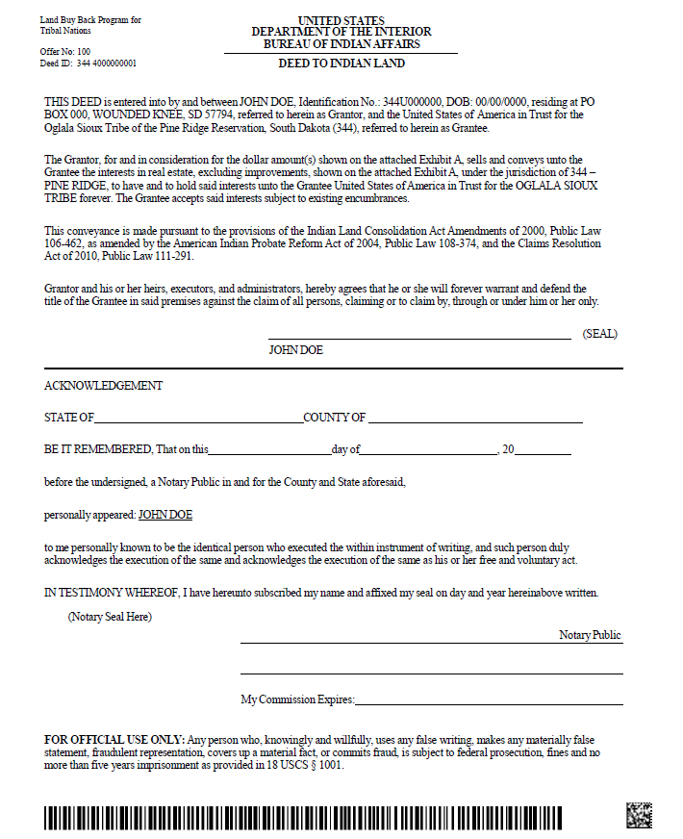
Step 1 (con’t): Review the Offer Package Documents
Deed

Slide 16
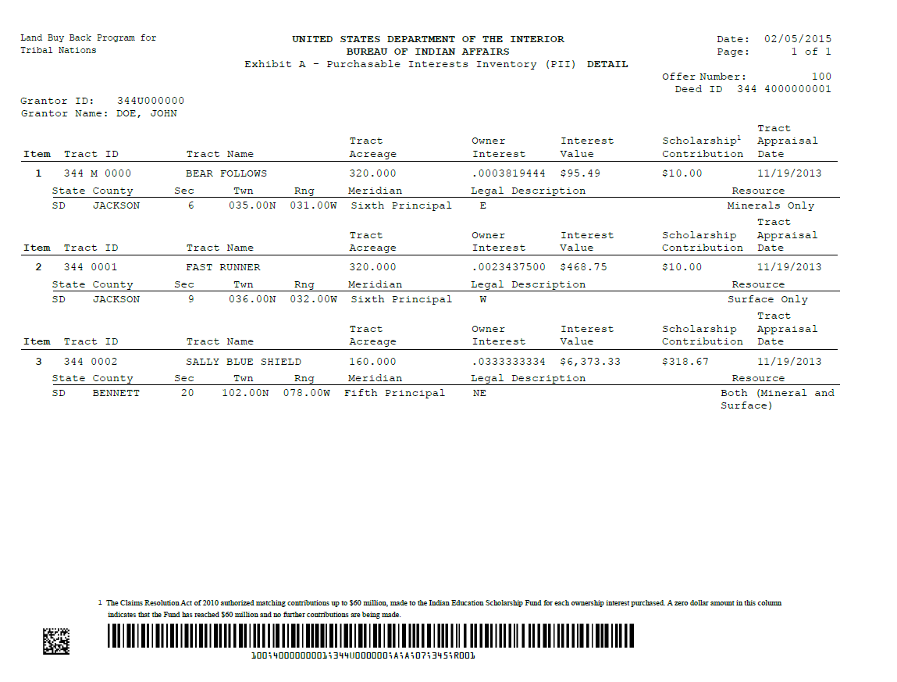
Exhibit A – Purchasable Interests Inventory DETAIL
Step 1 (con’t): Review the Offer Package Documents

Slide 17
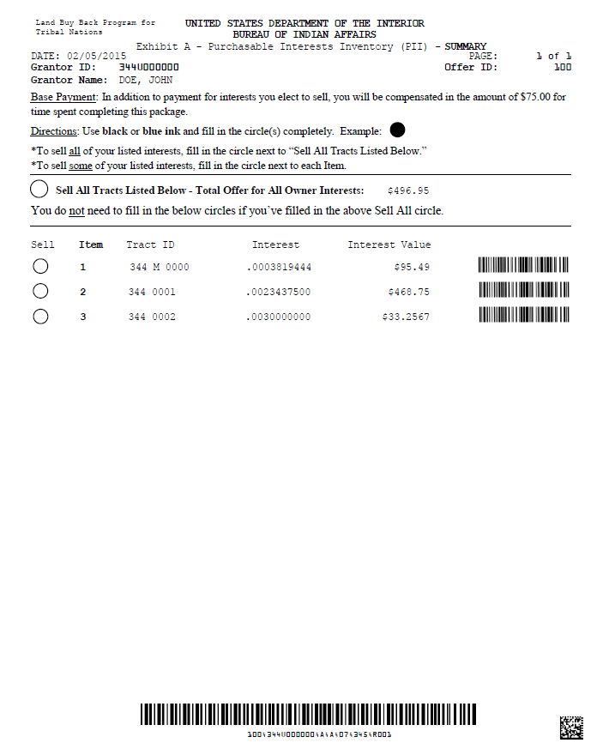
Exhibit A – Purchasable Interests Inventory SUMMARY
Step 1 (con’t): Review the Offer Package Documents

Slide 18
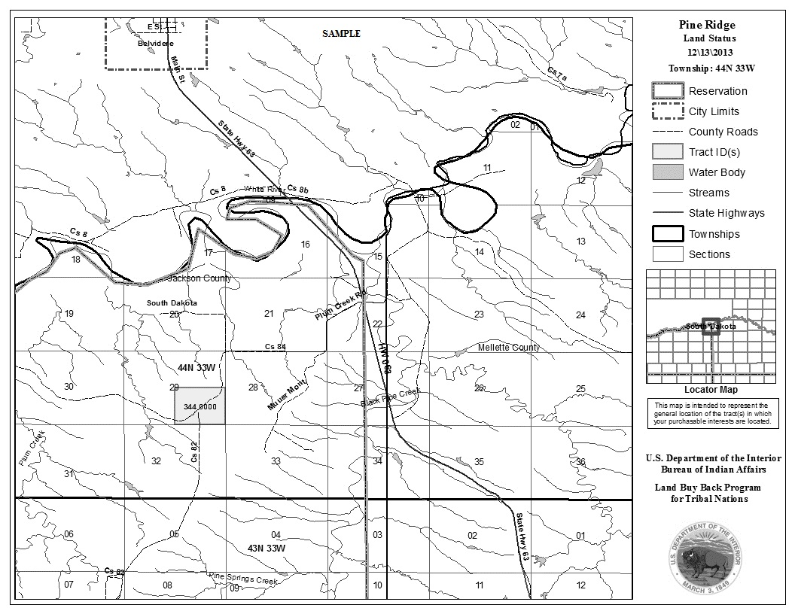
Step 1 (con’t): Review the Offer Package Documents
Map

Slide 19

Return Envelope
Step 1 (con’t): Review the Offer Package Documents
Please use envelope provided – extras are available
(If you mail in a regular envelope, do not use extended zip code for pre-sorted mail)

Slide 20
Step 2: Decide Which Interests to Select for Sale
Review tract information in DETAIL section of Inventory; obtain more information from Office of the Special Trustee/Trust Beneficiary Call Center or BIA if needed
To “Sell All” listed interests, fill in top bubble only on SUMMARY
To sell some interests, fill in bubble(s) next to Item number(s) on SUMMARY
Fill in bubbles completely with blue or black ink

Slide 21

Step 3: Take the Deed to a Notary Public
The Deed must be signed in front of a Notary
Legal identification (with photo) must be provided
Do not sign and return the Deed if personal information is incorrect (update information and obtain new Deed)
Do not make any other marks on the Deed
Make sure the Notary has placed a seal
on the Deed and filled in the fields correctly
CALIFORNIA RESIDENTS must include:
California All-Purpose Acknowledgement
Notary is free at all locations of Round Valley workshops

Slide 22
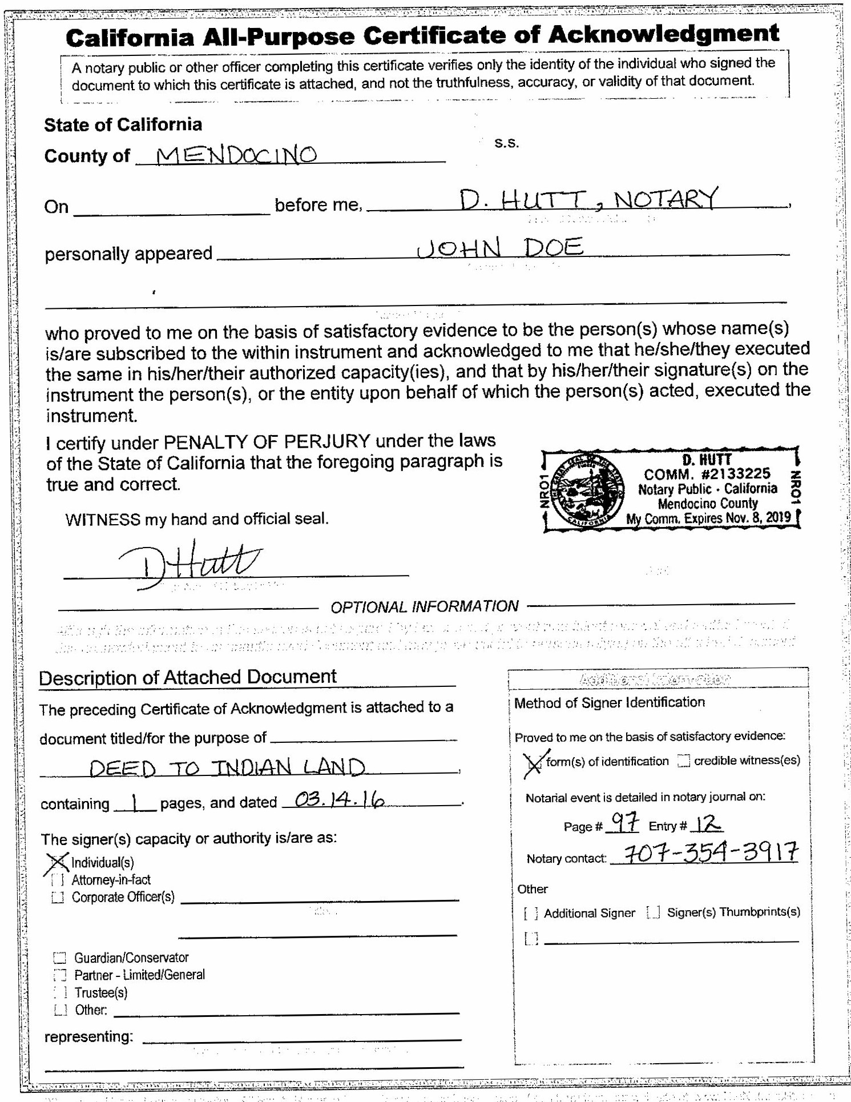
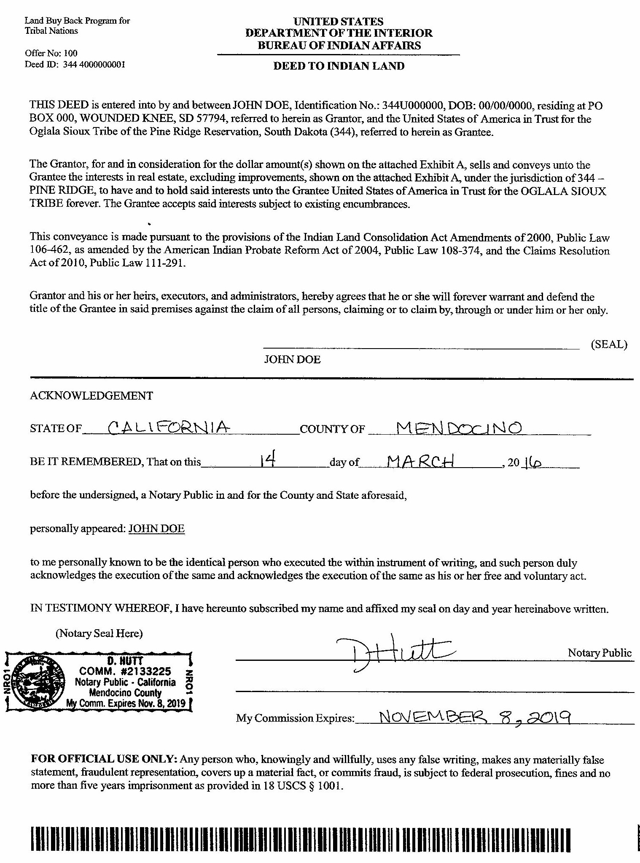
Step 3 (con’t): Take the Deed to a Notary Public
CALIFORNIA RESIDENTS ONLY
Use the California All-Purpose Acknowledgement form and filled in all fields correctly
Notary does NOT filled out

Slide 23
Step 4: Mail the Documents
Return the original signed and notarized Deed, and all pages of both parts of the Inventory (every page with a bar code at the bottom)
CALIFORNIA RESIDENTS must include a California All-Purpose Acknowledgement
Use the enclosed Business Reply Mail envelope
Think carefully about your decision and use care in making selections; once the sale is approved and title transfers to the Tribe, it cannot be reversed
Mail the documents by the deadline in the cover letter

Slide 24
Most Common Errors
Landowner returns either Deed or Inventory, but not both
The Deed is not signed
The Deed is not notarized properly
    Information or Notary seal is missing
    Information is incorrect (e.g., wrong year)
    Notary’s commission is expired
    California residents fail to include a California All-Purpose Acknowledgement

Slide 25
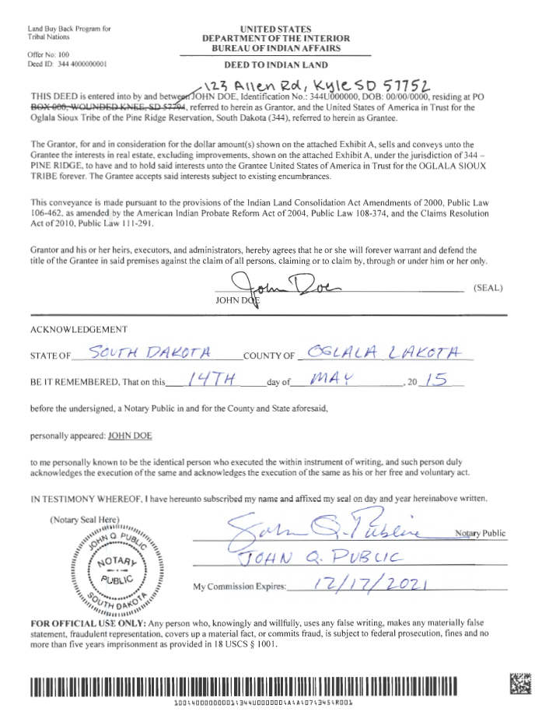
Example 1:
Landowner alteration to personal information on the Deed
Note: California landowners do not have Notary fill-out bottom section of Deed. Instead, use a Certificate of Acknowledgment

Slide 26
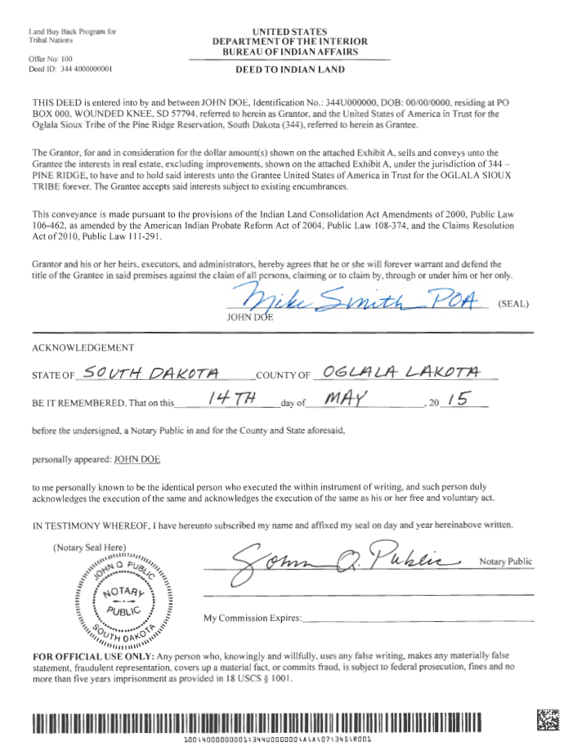
Example 2:
Deed signed by Power of Attorney rather than landowner
Note: California landowners do not have Notary fill-out bottom section of Deed. Instead, use a Certificate of Acknowledgment

Slide 27
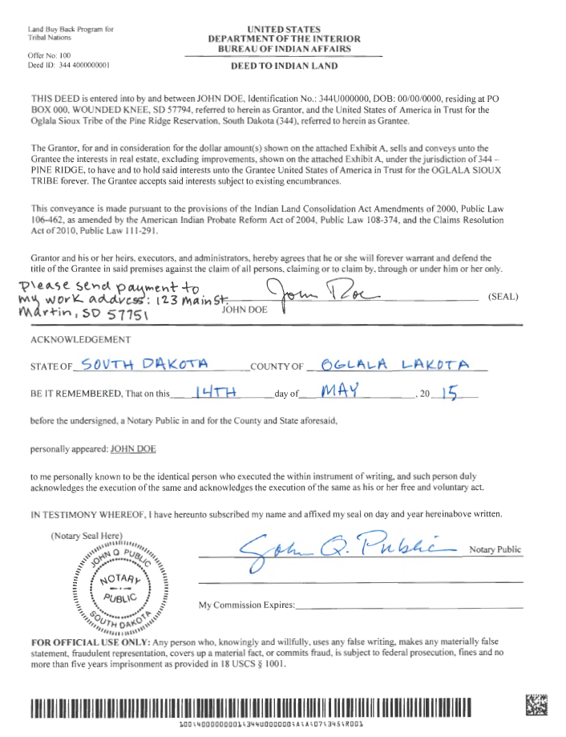
Example 3:
Landowner note on the Deed
Note: California landowners do not have Notary fill-out bottom section of Deed. Instead, use a Certificate of Acknowledgment

Slide 28
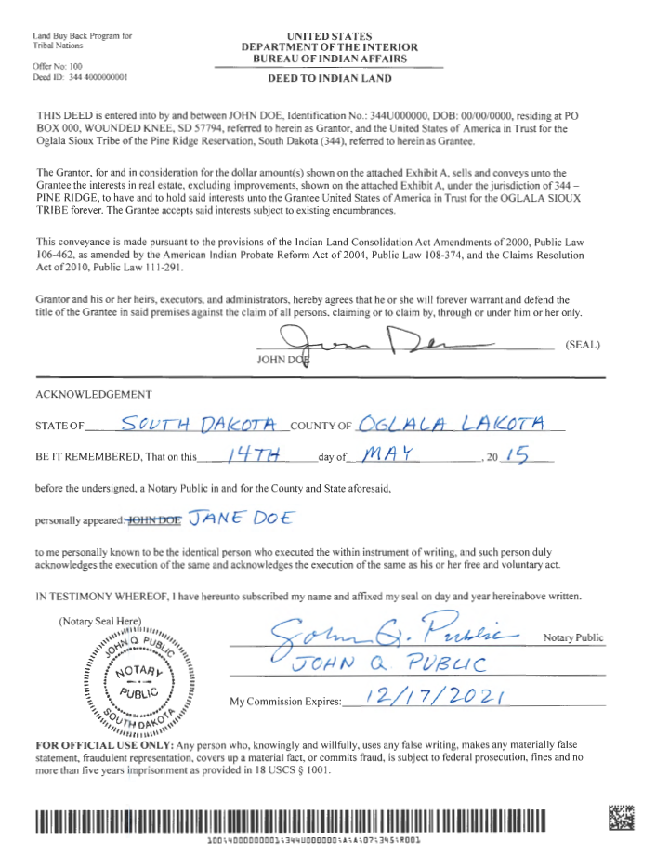
Example 4:
Notary alteration to landowner’s typed name on the Deed
Note: California landowners do not have Notary fill-out bottom section of Deed. Instead, use a Certificate of Acknowledgment

Slide 29
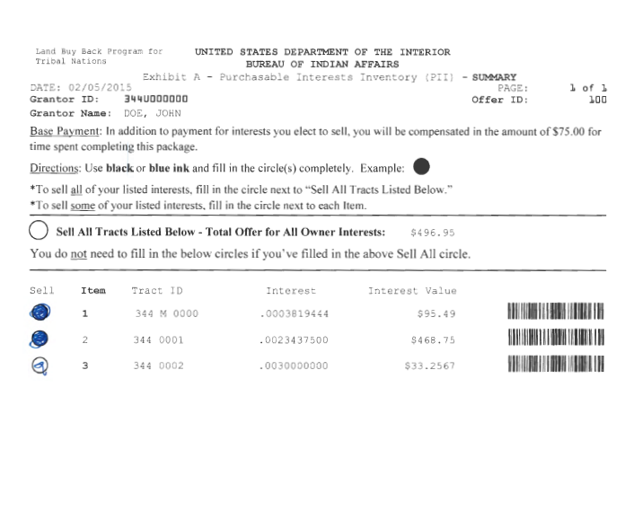
Example 5:
Unclear landowner selections on Inventory (bubble not completely filled in)

Slide 30
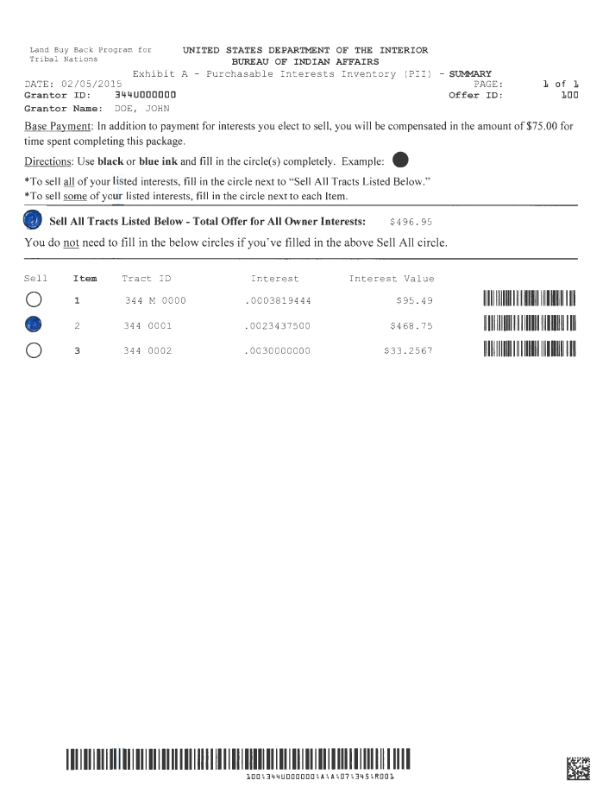
Example 6:
Unclear landowner selections on Inventory
(both “Sell All” and another bubble filled in)

Slide 31
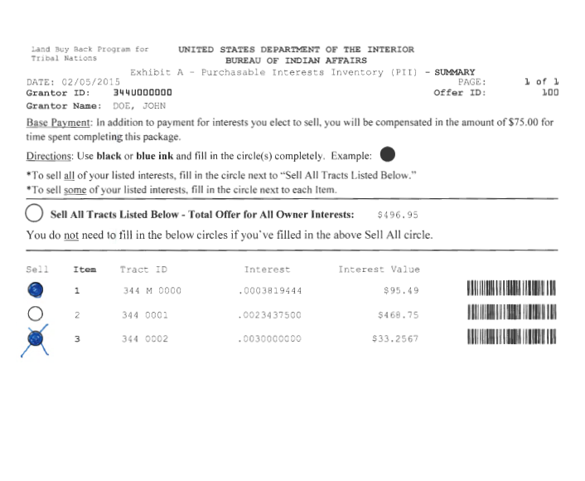
Example 7:
Unclear landowner selections on Inventory (cross-out)

Slide 32
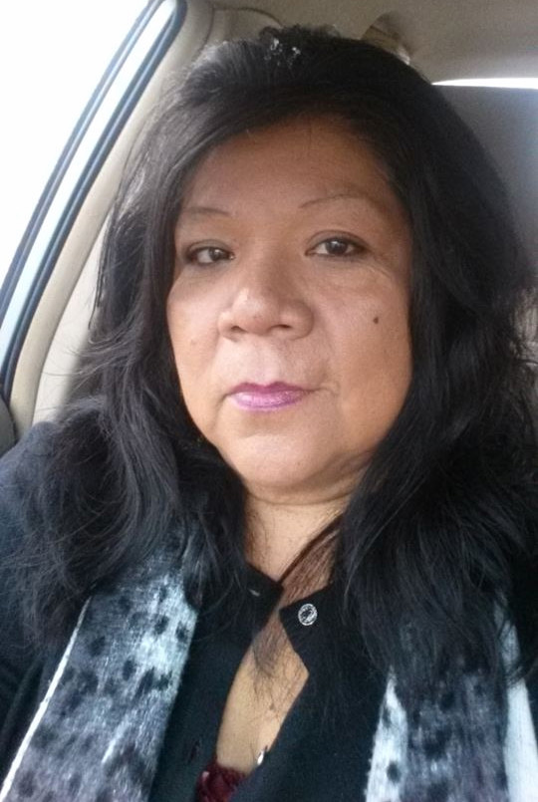
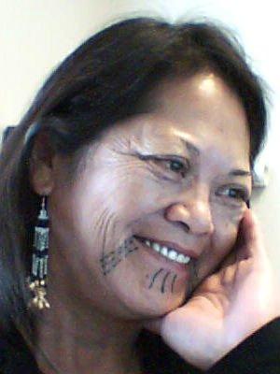

Round Valley Indian Tribes - Land Buy-Back Program
Office Address: 77600 Covelo Road
Mailing Address : 77826 Covelo Road
Covelo, CA 95428
Fax: (707) 983-6128
Point of Contacts:
Lynette Benton, Specialist (707) 354-5931
Renae Britton, Receptionist (707) 354-5943
Deborah Hutt, Director (707) 354-3917
Lynette Benton
Specialist
Deb Hutt
Director
Renae Britton
Receptionist
Office Hours: Mon-Fri 8:00-5:00pm (PST)
Website: http://www.cobell.rvit.org

Slide 33
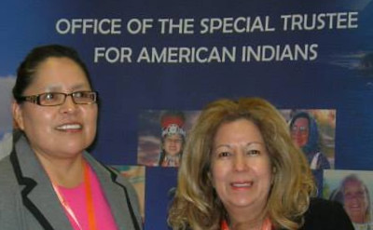
DOI - Office of Special Trustee
Tribal Beneficiary Call Center, OST (888) 678-6836
Mon-Fri 6:00-5:00pm/ Sat. 7:00-11:00(PST)
Diana Wuerth, FTO (916) 978-6045
Georgina Yazzie, OST (916) 978-6046
Mon-Fri 8:00-5:00pm (PST)
If you own property on other reservations, contact the Trust Beneficiary
Call Center or the Tribal Land Department where the land is located.

Slide 34
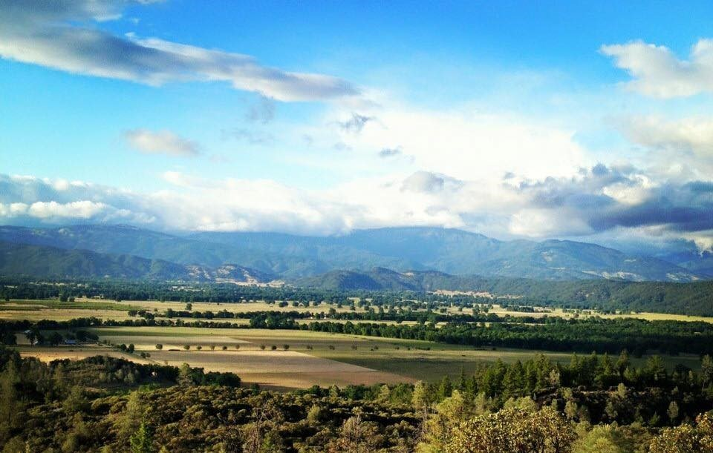
Round Valley Indian Reservation
A Sovereign Nation Of Confederated Tribes:
Yuki, Pit River, Nomlacki, Concow, Pomo, Wailacki
Established April 9, 1934

