Slide 1
IIM ACCOUNTS Individual Indian Money Accounts Also Known As Where Abouts Unknown Accounts Trust Beneficiary Call Center
Office of the Special Trustee for American Indians (OST)
Diana Wuerth, Fiduciary Trust Officer (FTO)
Field Operations, pacific region office, Sacramento, California

Slide 2
What do I do if my name is inaccurate?
Submit to OST copies of documents supporting your correct name consisting of:
Marriage Certificate (copy)
Adoption Papers (copy)
Social Security Card (copy)
Document requesting account holder name change (i.e., Court Order, Divorce Decree, etc.)

Slide 3
What if my Date of Birth is Wrong?
Submit to OST one of the following:
For accounts coded as Minor or Adult:
State issued Birth Certificate; or
Baptismal Certificate/Record
For accounts coded as Adult:
Drivers license; or
Government or State or Tribal identification; or
Tribal Enrollment Certification

Slide 4
How do I update my address?
Trust Beneficiary Call Center (TBCC) Toll-free: 1-888-678-6836
Form OST 01-004 Individual Indian Monies (IIM) Account
Account holder’s signature witnessed by someone 18 years of age or older
Letter requesting information at the OST table
Contact the local OST office at:
916-978-6045
916-978-6168

Slide 5
How will I receive my LBBP payment?
The payment will be deposited into your IIM account. If your account has a(n):
Unrestricted status, payment will automatically be processed if the balance is over $15.00 and/or you do not have any other real property interest
Voluntary Hold status, payment will be made upon your request
Contact the TBCC or OST to request the funds

Slide 6
How will I receive my LBBP payment?
Three methods available:
Direct Deposit: Automated Clearing House (ACH) electronic transfer to bank account on file
Check (US Treasury checks) mailed to address on record
Can’t cash immediately without checking account and the funds are on hold for up to ten business days at the bank
Checks get lost it will take 6 months to a year to recover funds
! Check cashing businesses - You will pay high fees !
Chase debit card (- spending limits, many fees)

Slide 7
When can I request changes to my account?
As Soon As Possible!!
Addresses provided to OST are used to send offer letters.
If you or family members are on the Where-Abouts Unknown (WAU) list, update your account address or you will not receive your offer
If you need to change your payment method, have your banking information available

Slide 8
Estate Planning
If you wish not to sell your interest, consider a Will and/or Gift Deeds
Proper planning allows you to decide who should receive your interest ownership upon your death
AIPRA probate regulations apply if there is not a will or gift deed in place
Check for a non profit legal organization for assistance

Slide 9
AIPRA American Indian Probate Reform Act of 2004

Slide 10
AIPRA < 5% (Less than)
Single Heir Rule
Oldest Living Child
Oldest Living Grandchild
Oldest Great Grandchild
If married $→$ spouse receives Life Estate and one of the above receives remainder
No living child, grandchild or great grandchild $→$tribe with jurisdiction
No eligible heir $→$ tribe with jurisdiction

Slide 11
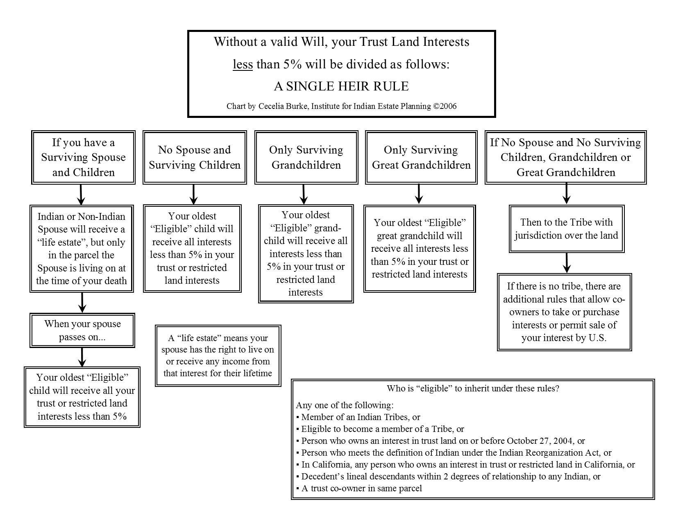
AIPRA < 5% (Less than)

Slide 12
What is a Life Estate?
Right to the use the land during a person’s lifetime
Will receive the income from that interest
Money generated from the Life Estate tracts go to the Life Estate holder
Separate IIM account for Life Estate Interests
Remainder is the Title Holder (Who will receive the land upon your death)
BIA assists in setting up Life Estates

Slide 13
How do I know if I own land?
Trust land is inherited from probate proceedings from a relative (i.e. grandparents, parents, cousins, children)
Gift deed (someone who freely gives you land)
Title holder (Life Estate)
25% of land owners don’t know they own land
We encourage you to visit one of the workshops to find out if you own land

Slide 14
How do I know if I have an Individual Indian Money (IIM) account?
Inherited from probate proceedings/Gift conveyance/Title holder (Life Estate)
Is your name on the Whereabouts Unknown listing
Please visit the OST table to find out if you have an IIM account

Slide 15
Questions?
Office of the Special Trustee Field Operations
Pacific Region office
Sacramento, CA
Trust Beneficiary Call Center
Albuquerque, New Mexico
1-888-678-6836
www.doi.gov/ost/fto

